Slide 1


DATA SCIENCE INTERNSHIP
TASK 3 – PHARMA ANALYSIS

Slide 2

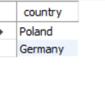
1) Retrieve all columns for all records in the dataset.
2)How many unique countries are represented in the dataset?

Slide 3
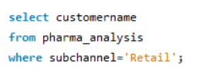
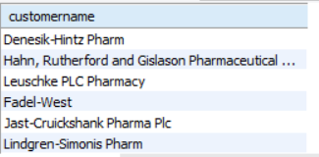
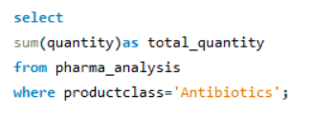

3)Select the names of all the customers on the 'Retail' channel.
4)Find the total quantity sold for the ' Antibiotics' product class.

Slide 4


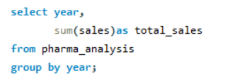
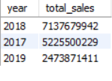
5)List all the distinct months present in the dataset.
6)Calculate the total sales for each year.

Slide 5
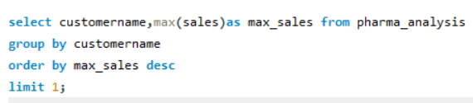

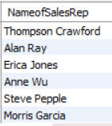
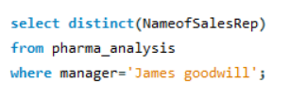
7)Find the customer with the highest sales value.
8)Get the names of all employees who are Sales Reps and are managed by 'James Goodwill'.

Slide 6
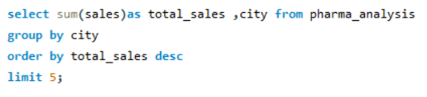
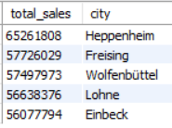

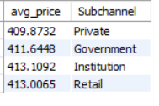
9)Retrieve the top 5 cities with the highest sales.
10)Calculate the average price of products in each sub-channel.

Slide 7

11)Join the 'Employees' table with the 'Sales' table to get the name of the Sales Rep and the corresponding sales records.
(There is no employee table)
12)Retrieve all sales made by employees from ' Rendsburg ' in the year 2018.

Slide 8

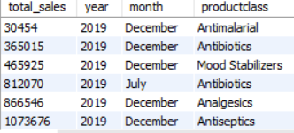
13)Calculate the total sales for each product class, for each month, and order the results by year, month, and product class.

Slide 9
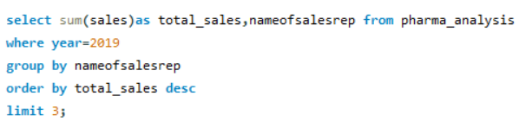
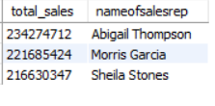

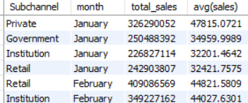
14)Find the top 3 sales reps with the highest sales in 2019.
15)Calculate the monthly total sales for each sub-channel, and then calculate the average monthly sales for each sub-channel over the years.

Slide 10
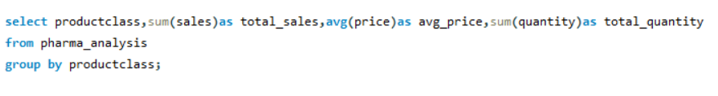
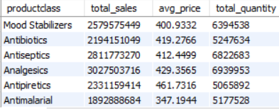
16)Create a summary report that includes the total sales, average price, and total quantity sold for each product class.

Slide 11
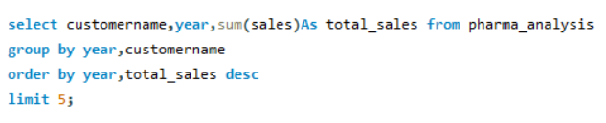
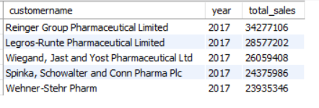
17)Find the top 5 customers with the highest sales for each year.

Slide 12
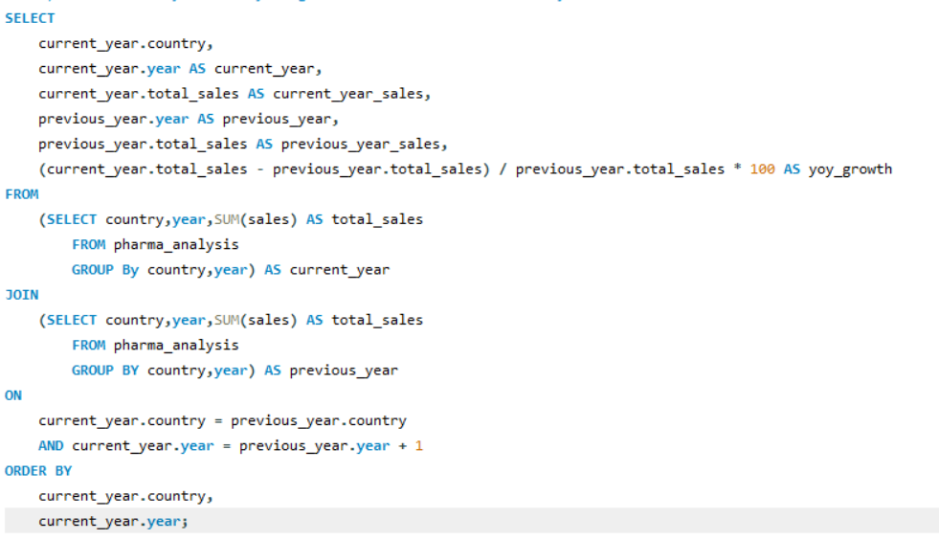
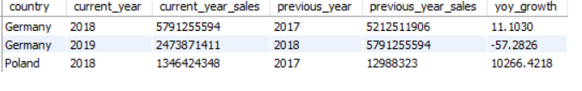
18)Calculate the year-over-year growth in sales for each country.

Slide 13
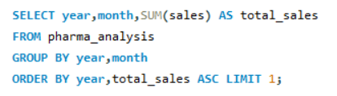

19)List the months with the lowest sales for each year

Slide 14
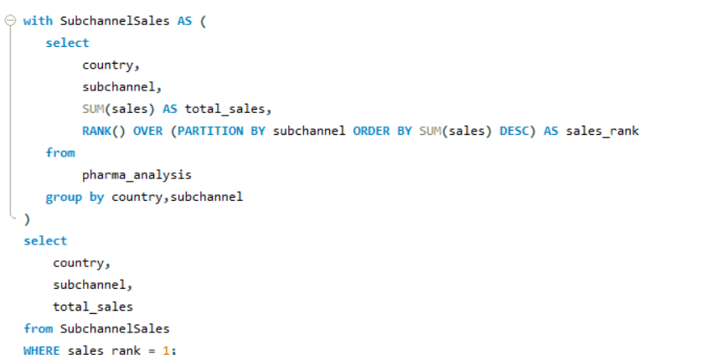
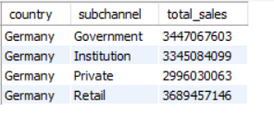
20)Calculate the total sales for each sub-channel in each country, and then find the country with the highest total sales for each sub-channel.

